Slide 1
Asylum Seekers in Germany
2015-today

Slide 2
745,545 applications for asylum
274,360 accepted

Slide 3
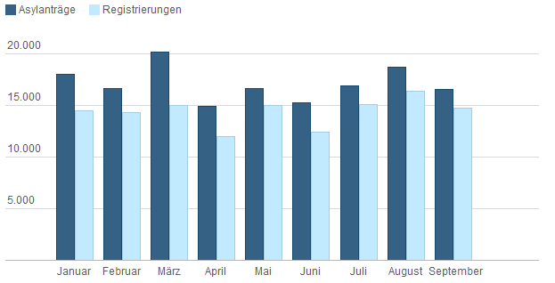
In 2017 so far…

Slide 4
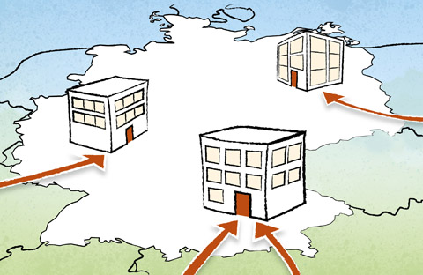
Arrival and Registration
Registration at the government agency after arrival.
Registration as asylum seekers during migration, report to border authorities.
Everyone is registered.
Registration consists of: a photo, personal information as well as fingerprints.
Not for under 14s.
After registration people receive proof of arrival.
It is an official document and must be carried at all times.
The document contains: personal information, accommodation, and medical care.

Slide 5
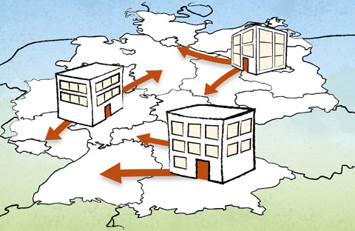
Initial Distribution of Asylum Seekers
Asylum seekers are taken in by the nearest reception facilities of the respective federal state.
It can be a temporary or long-term stay.
The application is adapted depending on the country of origin.
EASY is a quota system which ensures a fair distribution.
It can be 6 months or longer.

Slide 6
Decision
BAMF checks if the asylum seeker has already been in another state of the EU.
The European database is consulted.
If necessary, the application is rejected.
BAMF checks the asylum seeker’s need for protection.

Slide 7
Why Do People Flee Alone?
It can be too expensive or dangerous for other family members.
It is mostly young men who go.
After the people have asylum, they want to bring their families over.
Refugees who are granted asylum still face a lot of resistance.

Slide 8
Endless Waiting
1. Registration: a wait lasting days, weeks or months.
2. Proceeding with asylum: a wait lasting up to 24 months.
3. Administrative court: if necessary, complaining if the application was denied.
4. Entitlement to protection: according to the Geneva Refugee Convention, a married couple is allowed to have children under 18 brought to them, and children are allowed to have their parents brought over.
5. German Embassy: it lasts over a year in the embassies in Libanon, Jordan and Turkey.
6. Processing visas/leaving the country: the application has to be processed and leaving the country has to be organised.

Slide 9
Protection of Family in the Constitution
1. Marriages and families have special protection.
2. Taking care of and raising children is the natural right of parents.
3. Laws are the only reason why children can be taken against the will of those raising them.

Slide 10
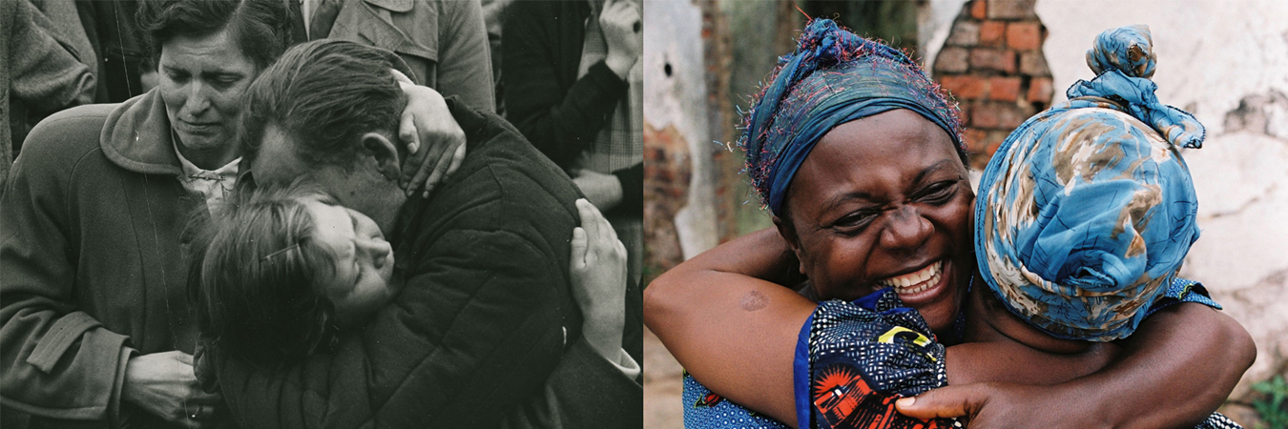
Thank you for your attention

